Slide 1
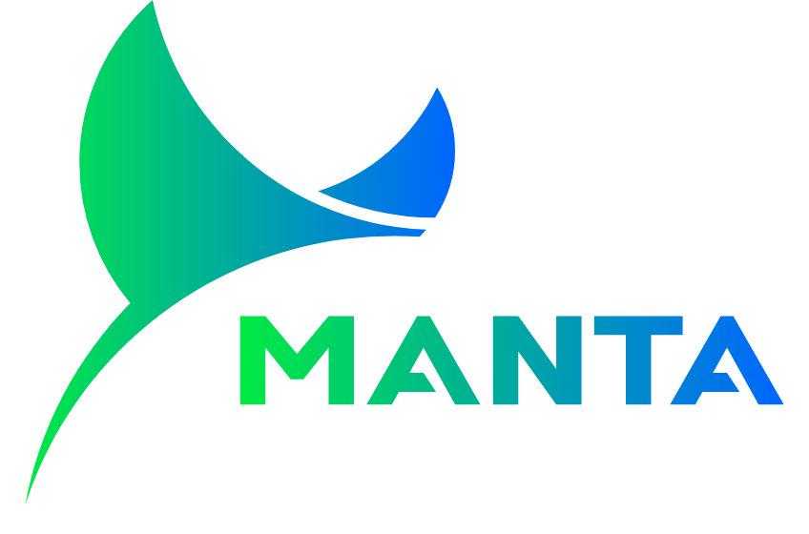
VPP
Transforming Distributed Energy Resources into
Intelligent Trading Assets
Notes:
单击此处添加文本

Slide 2
Product Overview
Enterprise-Grade VPP SaaS
Key Differentiators
Manta is an enterprise-grade Virtual Power Plant SaaS platform designed for energy retailers and aggregators. We transform the journey from "asset connectivity" to "scalable and sustainable revenue generation."
Trading-First Architecture
Every component optimized for financial performance
"Engineered for trading excellence — where intelligence meets execution."
AI at the Core
Enables third-party algorithm integration
Target Customers
Multi-Market Mastery
Spot, FCAS, Capacity — unified platform
Energy Retailers
Aggregators
Grid Operators
Notes:
单击此处添加文本

Slide 3
Product Functional Architecture
Notes:
单击此处添加文本

Slide 4
Core Capabilities
Overview
VPP Management
Spot Market
Visual asset operations dashboard with real-time metrics.
Rapid equipment grouping into virtual power plants.
Real-time trends, forecasts & intelligent arbitrage signals.
Operational Agility
Instant Revenue Pulse
Profit Maximization
Smart Feed-in
Cap Service
FCAS
Dynamic export rules & negative price protection.
Capacity charts and peak shaving/valley filling.
Visual ancillary service bidding & status management.
Risk Control
Demand Charge Reduction
Revenue Diversification
Reports
Onboarding
Strategy Market
Settlement-grade reports with customizable fields.
Rapid DER access & manufacturer integration.
Algorithm backtesting, listing & real-time yield ranking.
Financial Audit
Efficiency Enhancement
New Markets, New Profits
Notes:
单击此处添加文本

Slide 5
Rapid Der Onboarding
Pain Points
Competitive Advantage
Traditional VPP platforms require weeks for new device integration. Poor compatibility creates integration challenges with diverse "mixed-vendor" device ecosystems, severely limiting business scalability.
Onboarding Time
Weeks
Hours
Configuration Complexity
-95%
Manta's Universal Access Solution
Manufacturer Coverage
20+
Rapid Equipment Integration
Mainstream manufacturer equipment connected in hours, not weeks
Market-leading device compatibility
Unified Semantic Model
Standardized data models reduce configuration complexity by 95%
20+ Pre-integrated Manufacturers
Customer Value
Tesla, Sungrow, Huawei, SMA, GoodWe and more
Device onboarding is no longer a bottleneck. 90% faster integration enables rapid market response and competitive advantage.
Notes:
单击此处添加文本

Slide 6
Flexible Strategy Configuration
Pain Points
Competitive Advantage
Traditional VPP platforms typically employ simple fixed strategies with limited update capabilities. Strategy changes require code deployment, creating "blind flight" risks and high trial costs.
Strategy Development
Days
Minutes
Dramatically accelerated development cycle
Risk Control
100%
Verified
Manta's Solution
All strategies validated before deployment
Visual Strategy Orchestration
Backtest Data Coverage
1-3 Years
Intuitive visual workflow builder — build complex strategies like building blocks
Real market data (price, weather, load)
Real-time Historical Backtesting
Time Machine validates strategies with 1-3 years of market data
Instant Simulation Reports
Innovation Value
Results in seconds — profit curves, risk assessment
Strategy development evolves from "handcrafting" to "smart manufacturing". Business users build complex strategies without coding.
Notes:
单击此处添加文本

Slide 7
AI-Driven Dynamic Optimization
Pain Points
Quantified Benefits
Traditional VPP strategies remain static and rigid, unable to adapt to market evolution. Single-strategy approaches create blind spots and limit revenue potential.
Revenue Uplift
15-25%
vs. static rule-based systems
Strategy Update Frequency
Manta's AI Solution
5-Min
Real-time market adaptation
Model Arena
Support for third-party Python/Docker algorithms — break vendor lock-in
Risk Interception Rate
100%
Dynamic Selection & Racing
Real-time parallel execution — auto-switch to optimal strategy based on Revenue/MW
Auto-identify anomalous instructions
Adaptive Evolution
Reinforcement Learning — auto-tune parameters for seasonal changes
AI Empowerment
Manta's AI engine delivers "intelligence" — continuous learning, self-evolution, dynamic adaptation. The system gets smarter and more profitable over time.
Notes:
单击此处添加文本

